Slide 1

Jupyter Notebook and Jupyter Lab
Create interactive documents with live code, equations and visualizations
Notes:
Jupyter Notebook and Jupyter Lab are two popular open-source web applications that allow users to create and share documents that contain live code, equations, visualizations, and narrative text.

Slide 2

Table of Contents
Introduction to Jupyter Notebook and Jupyter Lab
Creating a New Jupyter Notebook
Understanding Jupyter Notebook
Working with Cells
Managing Files to Jupyter Notebook and Jupyter Lab
Google Colab & Jupyter Notebook

Slide 3
Introduction
Jupyter Notebook is a powerful tool for interactive computing. It allows you to combine code execution, text, mathematics, plots, and rich media into a single document. This tutorial will guide you through installing and using Jupyter Notebook on a Mac and Windows. We will also cover using Jupyter in Visual Studio Code and mention other IDEs where Jupyter is pre-installed.
You can install Jupyter Notebook using pip, which is a package installer for Python. Alternatively, you can install Jupyter Notebook through Anaconda, but we will not cover that method in this tutorial

Slide 4

What are Jupyter Notebook and Jupyter Lab?
Jupyter Notebook
Jupyter Notebook is a web-based interactive computational environment for creating, editing, and running Jupyter documents. It allows users to combine live code, equations, visualizations, and narrative text in a single document.
Jupyter Lab
Jupyter Lab is an extensible web-based environment for interactive and reproducible computing. It provides users with a more advanced and flexible interface than Jupyter Notebook, with support for multiple panes, drag and drop functionality, and custom extensions.
Notes:
Jupyter Notebook and Jupyter Lab are two open-source web applications that allow users to create and share documents that contain live code, equations, visualizations, and narrative text. Both applications support over 40 programming languages, including Python, R, Julia, and Scala. Jupyter Notebook is a web-based interactive computational environment for creating, editing, and running Jupyter documents, while Jupyter Lab is an extensible web-based environment for interactive and reproducible computing.

Slide 5
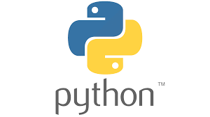
Getting Started
Before Installing Jupyter Notebooks or Jupyter Labs you need to have Python Installed on your computer
If Python is not installed, download and install it from the official Python website.
Open Terminal.
Ensure you have Python installed:
Check by typing: python3 --version

Slide 6


Installing Jupyter Notebook & Jupyter Lab Locally
For Windows & Mac
Complete the steps in the previous slide …
Open a terminal (mac) or command prompt (win)
Use pip, a package installer for Python
Install Jupyter Notebook and JupyterLab
Enter the command:
By default JupyterLab will index all folders in your computer
Instructions on how to configure it to only show specific directories in the next 02 slides
Notes:
To install Jupyter Notebook and JupyterLab, open a terminal or command prompt and use pip, a package installer for Python. Enter the command: pip install notebook jupyterlab. Original Content: You can install Jupyter Notebook and JupyterLab using pip, which is a package installer for Python. Open a terminal or command prompt. Install Jupyter Notebook and JupyterLab: sh Copy code pip install notebook jupyterlab

Slide 7
Limiting JupyterLab's indexing
Step 01 Create a jupyter_lab_config.py file:
Open a terminal or command prompt.
Navigate to the Jupyter configuration directory by running: jupyter --config-dir
In that directory, create a new file named jupyter_lab_config.py if it doesn't exist already.
Step 02 Configure the root directories:
Open the jupyter_lab_config.py file in a text editor
Add the following line to specify the directories you want Jupyter Lab to show:
c.ServerApp.root_dir = ['/path/to/directory1', '/path/to/directory2’]
Replace paths with the actual directories you want to include Separate multiple directories with commas

Slide 8
Limiting JupyterLab's indexing
Step 03 Restart Jupyter Lab
Save the jupyter_lab_config.py file
Restart your Jupyter Lab server for changes to take effect
Jupyter Lab to display only specified directories in the file browser
Notes
Directories can be added or removed from the root_dir list in the configuration file
Alternatively, specific files or directories can be hidden using a .hidden file in the workspace directory
Customizing indexed folders provides better control over workspace and privacy

Slide 9

Launching Jupyter Notebook
To start Jupyter Notebook: Open a terminal or command prompt.
Run the following command: jupyter notebook (Type a space between Jupyter and Notebook )
This will open a new tab in your default web browser showing the Jupyter Notebook interface.

Slide 10
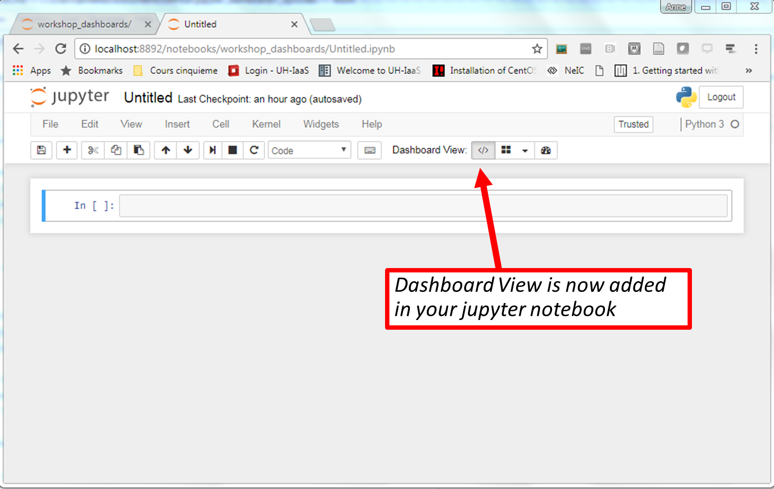
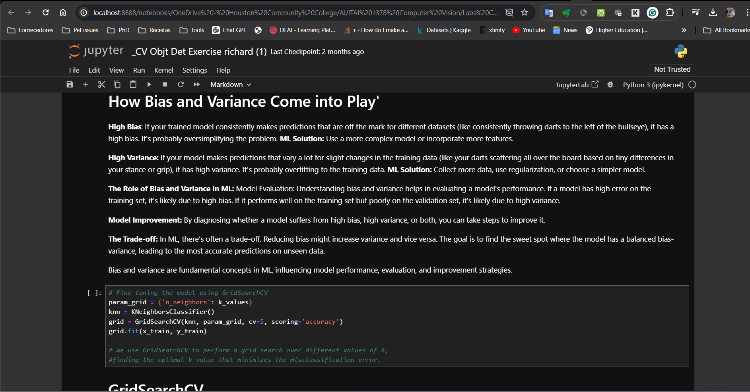
Understanding Jupyter Notebook
Jupyter Notebook Interface
Notebook Dashboard: This is the main landing page where you can see your files and notebooks. ( If you installed Jupyter Lab you may not have the dashboard vide)
Notebook: Consists of a sequence of cells, each of which can contain code, text (Markdown), mathematics, plots, and rich media.

Slide 11
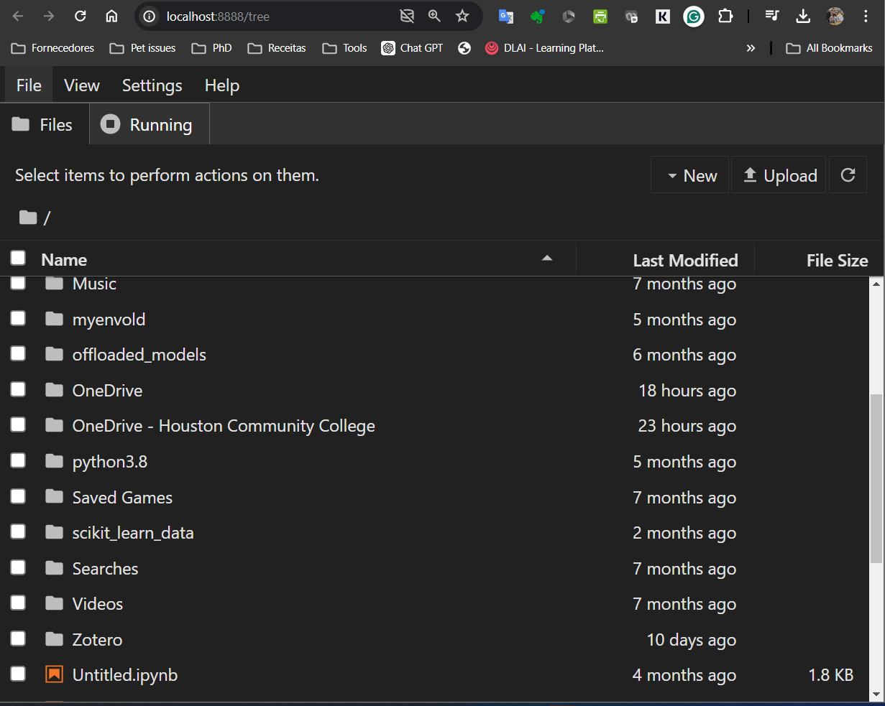
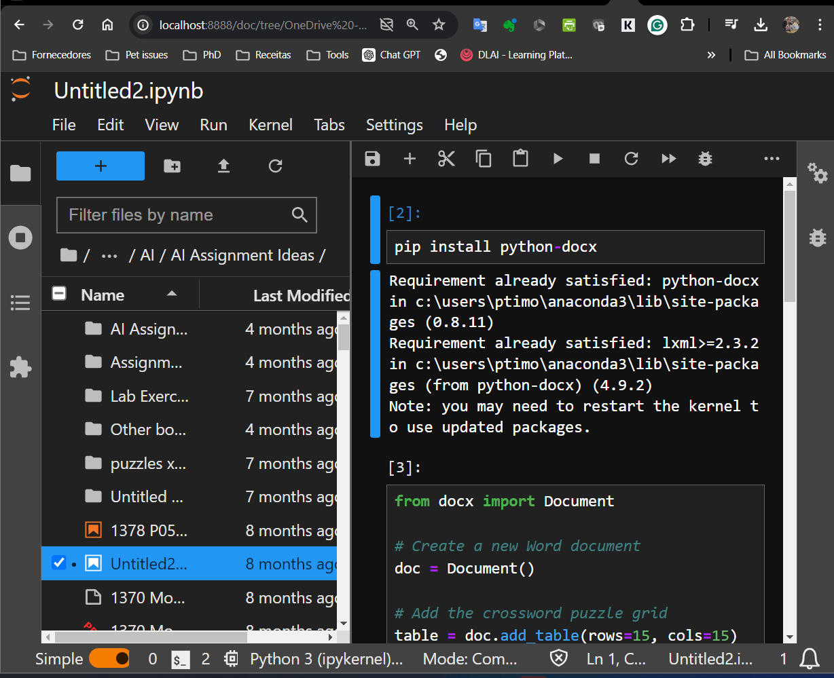
JupyterLab Interface
File browser panel of Jupyter Lab. This panel displays an indexed list of all the files and directories within the current workspace. Users can navigate through directories, open, rename and delete files, and perform various file management operations directly within Jupyter Lab.
File Browser:
Located on the left, it shows your files and allows you to navigate and manage them.
Displays an indexed list of all the files and directories within the current workspace.
Launcher: Provides quick access to create new notebooks, text files, terminals, and other activities.
Notebook: Similar to the Jupyter Notebook interface but with more flexible window management.
Notebook
Folders/Notebook files

Slide 12
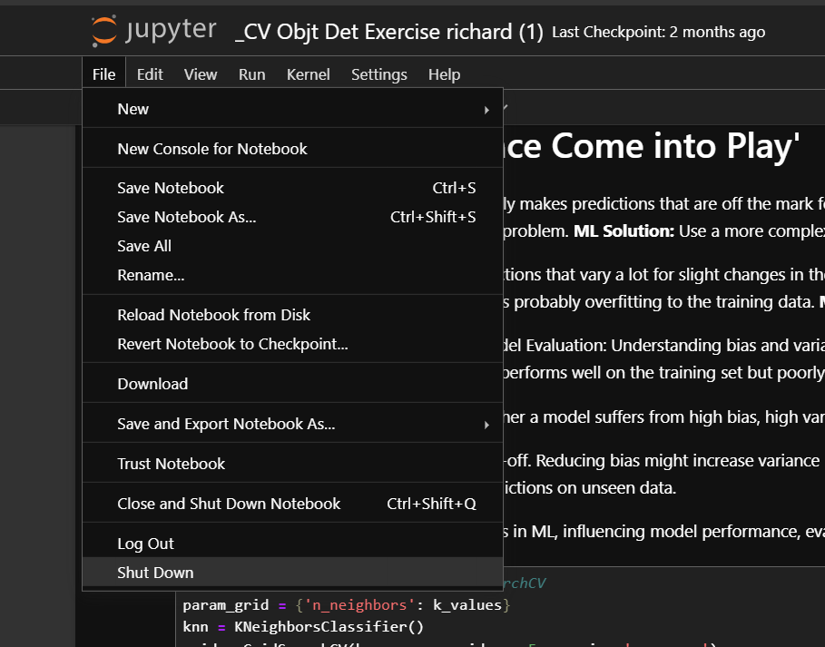
Creating a New Jupyter Notebook
Open Jupyter Notebook: Launch Jupyter Notebook in your web browser.
Create a New Notebook: Click on File (in the menu bar) then "New" dropdown menu. Select your preferred programming language (e.g., Python 3).
Notes:
To create a new Jupyter Notebook, we need to open Jupyter Notebook in our web browser, select the New dropdown menu, and choose the programming language of our choice. Once we have created a new Notebook, we can start adding cells to it.

Slide 13

Working with Cells
Jupyter Notebooks and JupyterLab notebooks are composed of cells.
There are two main types of cells: Markdown cells and Code cells.

Slide 14
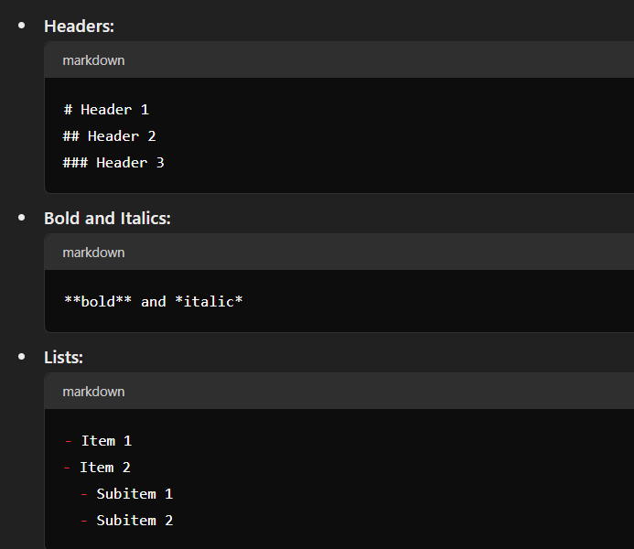
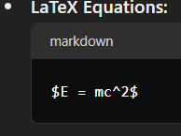
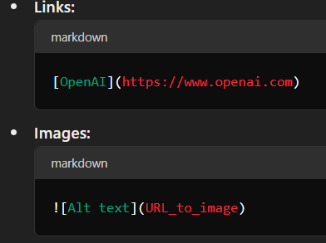
Markdown Cells
Markdown cells are used for text. You can write plain text, formatted text, lists, links, images, and even LaTeX equations.
Creating a Markdown Cell: Click on an empty cell and change its type to Markdown using the toolbar or by pressing Esc followed by M.
Writing Markdown: Here are some examples of Markdown syntax:

Slide 15
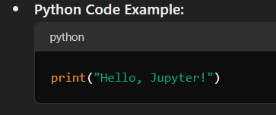

Code Cells
Code cells are used to write and execute code. The code is executed in the kernel, and the output is displayed below the cell.
Creating a Code Cell: Click on an empty cell and change its type to Code using the toolbar or by pressing Esc followed by Y.
Writing and Executing Code:
Running the Code: Press ‘Shift + Enter’ to run the code in the cell and move to the next cell, or ‘Ctrl + Enter’ to run the code and stay in the same cell.

Slide 16
Understanding the Kernel in Jupyter
A kernel is a computational engine that executes the code contained in a Jupyter Notebook.
Role: It processes the code cells, executes the commands, and returns the results back to the notebook.
Key Features
Code Execution: Runs the code in the cells.
Memory Management: Keeps the variables, functions, and states in memory for the duration of the session.
Language Support: Default kernel is for Python, but Jupyter supports kernels for other languages like R, Julia, and more.
Interactions with the Kernel
Starting the Kernel: When you open a notebook, a new kernel is started.
Stopping the Kernel: You can stop the kernel manually, which will halt all code execution.
Restarting the Kernel: If your kernel crashes or you need a fresh start, you can restart it
Kernel Status
Busy: Kernel is currently executing code (circle filled).
Idle: Kernel is ready to execute new code (circle empty).

Slide 17

Managing Files to Jupyter Notebook and Jupyter Lab
Upload Files
To upload files in Jupyter Notebook and JupyterLab:
Go to the Home tab: Open Jupyter Notebook or JupyterLab.
Click the Upload button: Located in the Home tab or file browser pane.
Choose files to upload: Select the files from your local machine that you want to upload.
Confirm the upload: Click the "Upload" button next to each file to finalize the process.
Create New Files
To create new files in Jupyter Notebook and JupyterLab:
Select the New dropdown menu: Located in the Home tab or file browser pane.
Choose the type of file to create: Options include Notebook, Text File, Folder, and Terminal.
Notebook: Create a new Jupyter Notebook.
Text File: Create a new text file.
Folder: Create a new folder to organize your files.
Terminal: Open a new terminal session for command-line operations.

Slide 18

Working with Jupyter: Local vs Cloud IDEs
Local Installation
When to Install Jupyter:
Install Jupyter Notebook or JupyterLab if you plan to work on your local machine.
Follow the installation instructions for Mac or Windows to set up Jupyter locally.
Key Benefits of Cloud IDEs
Ease of Access: Use Jupyter from any device with internet access.
Collaboration: Work simultaneously with others on the same notebook.
Compute Resources: Leverage powerful cloud resources, including GPUs and TPUs, for intensive tasks.

Slide 19

Examples of Cloud IDEs
AWS SageMaker Studio Lab:
Sign up or log in at AWS SageMaker Studio Lab.
Jupyter is pre-installed and ready to use.
Azure AI Copilot:
Access Jupyter notebooks directly within the Azure AI Copilot environment.
No local installation required.
Google Colab:
Visit Google Colab.
Jupyter environment is available online without installation.
Other Cloud IDEs:
Many cloud-based platforms provide ready-to-use Jupyter environments.
Check the specific IDE's documentation for details.

Slide 20


Google Colab & Jupyter Notebok
Google Colab (Collaboratory) is a free, cloud-based platform that provides a Jupyter Notebook environment.
Similarities to Jupyter Notebook
Notebook Interface: Colab uses the same Jupyter Notebook interface, with support for Markdown and Code cells.
Code Execution: You can write and execute Python code interactively.
Rich Media: Supports text, images, LaTeX, and other rich media elements.

Slide 21

Conclusion
Jupyter Notebook and Jupyter Lab are powerful tools for creating and sharing interactive and reproducible documents. They provide a flexible and user-friendly environment for data analysis, scientific computing, and other applications.
Notes:
Jupyter Notebook and Jupyter Lab are powerful tools for creating and sharing interactive and reproducible documents. They provide a flexible and user-friendly environment for data analysis, scientific computing, and other applications. By following this tutorial, you have learned how to use Jupyter Notebook and Jupyter Lab, including how to add files, and the difference between code cells and markup cells. We hope this presentation was helpful and informative!

